Slide 1
Parameter Estimation in Matlab
Files on GitHub
Simple_Opt.m
Opt_Monod.m
Opt_LinearPath.m
Parameter Estimation in Matlab.pptx
Get the files at:
https://github.com/LBSA-VoitLab/MATLAB_optimization
Notes:
Note that files are always automatically saved in Matlab. Therefore, the original settings may be different.

Slide 2
Methods in Matlab
Local Opt
Global Opt
Minimization Functions
fmincon
fminunc
fminsearch
Global Optimization TB
Genetic Algorithm
Simulated Annealing
Least Squares Functions
lsqcurvefit
lsqlin
lsqnonlin
GUI
optimtool

Slide 3
Nelder-Mead (fminseach)
sample two (1D) points (n+1 points for nD)
See which is the point with smallest loss
The other points take a step down
Gradient Descent
(fminunc)
Calculate the gradient ∇F(Xn) is at the current point
take a step down the gradient
Xn+1 = Xn − α∇F(Xn)
https://www.benfrederickson.com/numerical-optimization/

Slide 4
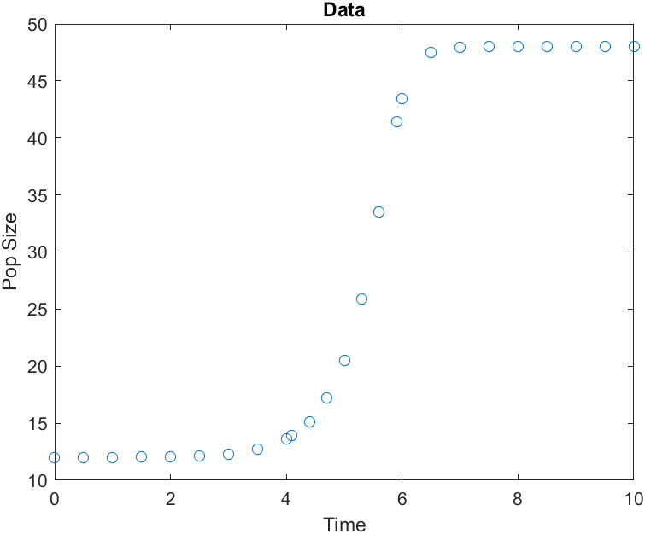
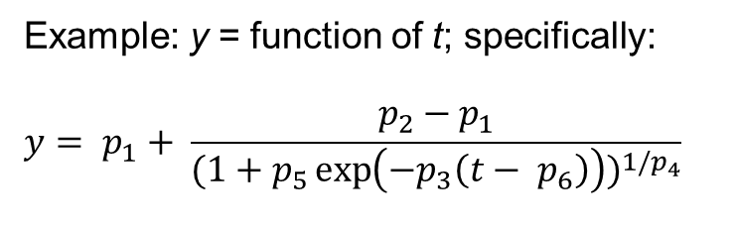
Break down of the Simple_Opt
Data
Exp_data =
0 12.0021
0.5000 12.0047
1.0000 12.0109
1.5000 12.0251
2.0000 12.0577
2.5000 12.1328
3.0000 12.3056
3.5000 12.7032
4.0000 13.6180
4.1000 13.9114
4.4000 15.1509
4.7000 17.1909
5.0000 20.5287
5.3000 25.8510
5.6000 33.5000
5.9000 41.4622
6.0000 43.4489
6.5000 47.5205
7.0000 47.9597
7.5000 47.9967
8.0000 47.9997
8.5000 48.0000
9.0000 48.0000
9.5000 48.0000
10.0000 48.0000
Example: y = function of t; specifically:
$$y= p_{1}+ \frac{p_{2}−p_{1}}{{(1+p_{5}\exp\left(−p_{3}\left(t− p_{6}\right)\right))}^{1/p_{4}}}$$
function z=dataset(dataset)
switch dataset
case 1
z=[ 0 12.0021
0.5000 12.0047
…
10.0000 48.0000];
end
end
Notes:
We start with data and an equation or system

Slide 5
Simple_Opt
Cost function
function z=Cost(p,g)
Exp_data=dataset(1);
t=[0:.1:10]';
y=p(1)+(p(2)-p(1))./(1+p(5)*exp(-p(3)*(t-p(6)))).^(1/p(4));
ys=interp1(t,y,Exp_data(:,1));
Cost=sum((Exp_data(:,2)-ys).^2);
If g==1
subplot(2,1,1)
plot(t,y)
hold on
plot(Exp_data(:,1),Exp_data(:,2),'o')
hold off
subplot(2,1,2)
plot(Exp_data(:,1),Exp_data(:,2)
-ys,'o')
end
z=Cost;
end
Exp_data =
0 12.0021
0.5000 12.0047
1.0000 12.0109
1.5000 12.0251
2.0000 12.0577
2.5000 12.1328
3.0000 12.3056
3.5000 12.7032
4.0000 13.6180
4.1000 13.9114
4.4000 15.1509
4.7000 17.1909
5.0000 20.5287
5.3000 25.8510
5.6000 33.5000
5.9000 41.4622
6.0000 43.4489
6.5000 47.5205
7.0000 47.9597
7.5000 47.9967
8.0000 47.9997
8.5000 48.0000
9.0000 48.0000
9.5000 48.0000
10.0000 48.0000
Notes:
Cost function.
Retrieve data that is passed to the script also as a function.

Slide 6
Simple_Opt
Cost function
function z=Cost(p,g)
Exp_data=dataset(1);
t=[0:.1:10]';
y=p(1)+(p(2)-p(1))./(1+p(5)*exp(-p(3)*(t-p(6)))).^(1/p(4));
ys=interp1(t,y,Exp_data(:,1));
Cost=sum((Exp_data(:,2)-ys).^2);
If g==1
subplot(2,1,1)
plot(t,y)
hold on
plot(Exp_data(:,1),Exp_data(:,2),'o')
hold off
subplot(2,1,2)
plot(Exp_data(:,1),Exp_data(:,2)
-ys,'o')
end
z=Cost;
end
Dense time intervals
Exp_data =
0 12.0021
0.5000 12.0047
1.0000 12.0109
1.5000 12.0251
2.0000 12.0577
2.5000 12.1328
3.0000 12.3056
3.5000 12.7032
4.0000 13.6180
4.1000 13.9114
4.4000 15.1509
4.7000 17.1909
5.0000 20.5287
5.3000 25.8510
5.6000 33.5000
5.9000 41.4622
6.0000 43.4489
6.5000 47.5205
7.0000 47.9597
7.5000 47.9967
8.0000 47.9997
8.5000 48.0000
9.0000 48.0000
9.5000 48.0000
10.0000 48.0000
t =
0
0.1000
0.2000
0.3000
0.4000
0.5000
0.6000
0.7000
0.8000
0.9000
1.0000
1.1000
1.2000
1.3000
1.4000
1.5000
1.6000
1.7000
1.8000
1.9000
2.0000
2.1000
2.2000
2.3000
2.4000
2.5000
......
Notes:
Define time for the simulation.
We are using a simulation time step smaller than the data.

Slide 7
Simple_Opt
Cost function
function z=Cost(p,g)
Exp_data=dataset(1);
t=[0:.1:10]';
y=p(1)+(p(2)-p(1))./(1+p(5)*exp(-p(3)*(t-p(6)))).^(1/p(4));
ys=interp1(t,y,Exp_data(:,1));
Cost=sum((Exp_data(:,2)-ys).^2);
If g==1
subplot(2,1,1)
plot(t,y)
hold on
plot(Exp_data(:,1),Exp_data(:,2),'o')
hold off
subplot(2,1,2)
plot(Exp_data(:,1),Exp_data(:,2)
-ys,'o')
end
z=Cost;
end
Exp_data =
0 12.0021
0.5000 12.0047
1.0000 12.0109
1.5000 12.0251
2.0000 12.0577
2.5000 12.1328
3.0000 12.3056
3.5000 12.7032
4.0000 13.6180
4.1000 13.9114
4.4000 15.1509
4.7000 17.1909
5.0000 20.5287
5.3000 25.8510
5.6000 33.5000
5.9000 41.4622
6.0000 43.4489
6.5000 47.5205
7.0000 47.9597
7.5000 47.9967
8.0000 47.9997
8.5000 48.0000
9.0000 48.0000
9.5000 48.0000
10.0000 48.0000
t =
0
0.1000
0.2000
0.3000
0.4000
0.5000
0.6000
0.7000
0.8000
0.9000
1.0000
1.1000
1.2000
1.3000
1.4000
1.5000
1.6000
1.7000
1.8000
1.9000
2.0000
2.1000
2.2000
2.3000
2.4000
2.5000
......
y =
12.0021
12.0024
12.0029
12.0034
12.0040
12.0047
12.0056
12.0066
12.0078
12.0092
12.0109
12.0129
12.0152
12.0180
12.0212
12.0251
12.0296
12.0350
12.0414
12.0489
12.0577
12.0682
12.0806
12.0952
12.1124
......
Notes:
Values of y extrapolated for dense time points

Slide 8
Simple_Opt
Cost function
function z=Cost(p,g)
Exp_data=dataset(1);
t=[0:.1:10]';
y=p(1)+(p(2)-p(1))./(1+p(5)*exp(-p(3)*(t-p(6)))).^(1/p(4));
ys=interp1(t,y,Exp_data(:,1));
Cost=sum((Exp_data(:,2)-ys).^2);
If g==1
subplot(2,1,1)
plot(t,y)
hold on
plot(Exp_data(:,1),Exp_data(:,2),'o')
hold off
subplot(2,1,2)
plot(Exp_data(:,1),Exp_data(:,2)
-ys,'o')
end
z=Cost;
end
Exp_data =
0 12.0021
0.5000 12.0047
1.0000 12.0109
1.5000 12.0251
2.0000 12.0577
2.5000 12.1328
3.0000 12.3056
3.5000 12.7032
4.0000 13.6180
4.1000 13.9114
4.4000 15.1509
4.7000 17.1909
5.0000 20.5287
5.3000 25.8510
5.6000 33.5000
5.9000 41.4622
6.0000 43.4489
6.5000 47.5205
7.0000 47.9597
7.5000 47.9967
8.0000 47.9997
8.5000 48.0000
9.0000 48.0000
9.5000 48.0000
10.0000 48.0000
ys =
12.0021
12.0047
12.0109
12.0251
12.0577
12.1328
12.3056
12.7032
13.6180
13.9114
15.1509
17.1909
20.5287
25.8510
33.5000
41.4622
43.4489
47.5205
47.9597
47.9967
47.9997
48.0000
48.0000
48.0000
48.0000
Notes:
Values of y restricted to time points corresponding to data

Slide 9
Simple_Opt
Cost function
function z=Cost(p,g)
Exp_data=dataset(1);
t=[0:.1:10]';
y=p(1)+(p(2)-p(1))./(1+p(5)*exp(-p(3)*(t-p(6)))).^(1/p(4));
ys=interp1(t,y,Exp_data(:,1));
Cost=sum((Exp_data(:,2)-ys).^2);
If g==1
subplot(2,1,1)
plot(t,y)
hold on
plot(Exp_data(:,1),Exp_data(:,2),'o')
hold off
subplot(2,1,2)
plot(Exp_data(:,1),Exp_data(:,2)
-ys,'o')
end
z=Cost;
end
Calculate the cost as the sum of the squares of the difference between the data and the model results.

Slide 10
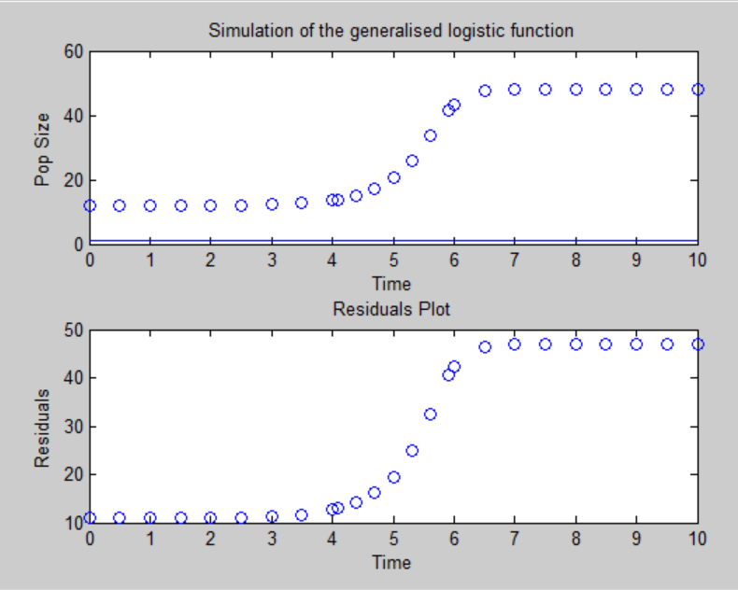
Simple_Opt
Cost function
function z=Cost(p,g)
Exp_data=dataset(1);
t=[0:.1:10]';
y=p(1)+(p(2)-p(1))./(1+p(5)*exp(-p(3)*(t-p(6)))).^(1/p(4));
ys=interp1(t,y,Exp_data(:,1));
Cost=sum((Exp_data(:,2)-ys).^2);
If g==1
subplot(2,1,1)
plot(t,y)
hold on
plot(Exp_data(:,1),Exp_data(:,2),'o')
hold off
subplot(2,1,2)
plot(Exp_data(:,1),Exp_data(:,2)
-ys,'o')
end
z=Cost;
end
Value of cost function without optimization:
ans = 2.4902e+04
Notes:
Plots to visualize the results.

Slide 11
function z=Simple_Opt()
clc
p0=[1 % p1 the lower asymptote
1 % p2 the upper asymptote
1 % p3 the growth rate
1 % p4 how max. growth occurs
1 % p5 depend. on y(0)
1]; % p6 the time of max growth
z=Cost(p0,1);
% p2=fminsearch(@Cost,p0,[],0)
% z=Cost(p2,1);
end
function z=Cost(p,g)
Exp_data=dataset(1);
t=[0:.1:10]';
y=p(1)+(p(2)-p(1))./(1+p(5)*exp(-p(3)*(t-p(6)))).^(1/p(4));
ys=interp1(t,y,Exp_data(:,1));
Cost=sum((Exp_data(:,2)-ys).^2);
If g==1
subplot(2,1,1)
plot(t,y)
hold on
plot(Exp_data(:,1),Exp_data(:,2),'o')
hold off
subplot(2,1,2)
plot(Exp_data(:,1),Exp_data(:,2)
-ys,'o')
end
z=Cost;
end
function z=dataset(dataset)
switch dataset
case 1
z=[ 0 12.0021
0.5000 12.0047
10.0000 48.0000];
end
end

Slide 12
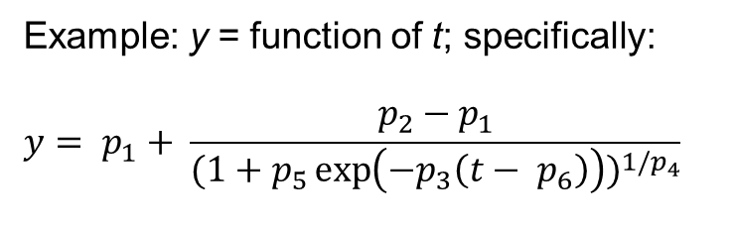
Simple_Opt
Optimization call
function z=Simple_Opt()
clc
p0=[1 % p1 the lower asymptote
1 % p2 the upper asymptote
1 % p3 stretch and contract t
1 % p4 reshapes the function
1 % p5 stretch and contract y
1]; % p6 the time of max growth
z=Cost(p0,1);
p2=fminsearch(@Cost,p0,[],0)
z=Cost(p2,1);
end
Initial guess for the parameter (p0)
Example: y = function of t; specifically:
$$y= p_{1}+ \frac{p_{2}−p_{1}}{{(1+p_{5}\exp\left(−p_{3}\left(t− p_{6}\right)\right))}^{1/p_{4}}}$$
Notes:
Hand-select better start values. Check each with z=Cost(p0,1).

Slide 13
Simple_Opt
Optimization call
function z=Simple_Opt()
clc
p0=[1 % p1 the lower asymptote
1 % p2 the upper asymptote
1 % p3 stretch and contract t
1 % p4 reshapes the function
1 % p5 stretch and contract y
1]; % p6 the time of max growth
z=Cost(p0,1);
p2=fminsearch(@Cost,p0,[],0)
z=Cost(p2,1);
end
Calculate the cost of the parameters initial guess (p0)
Notes:
Hand-select better start values. Check each with z=Cost(p0,1).

Slide 14
Simple_Opt
Optimization call
function z=Simple_Opt()
clc
p0=[1 % p1 the lower asymptote
1 % p2 the upper asymptote
1 % p3 stretch and contract t
1 % p4 reshapes the function
1 % p5 stretch and contract y
1]; % p6 the time of max growth
z=Cost(p0,1);
p2=fminsearch(@Cost,p0,[],0)
z=Cost(p2,1);
end
Call the optimizer
Optimized parameters stored in p2
With the cost function ?@?
With initial parameter guess p0
[] no optimization options
Do not draw the cost function plots

Slide 15
Simple_Opt
Optimization call
function z=Simple_Opt()
clc
p0=[1 % p1 the lower asymptote
1 % p2 the upper asymptote
1 % p3 stretch and contract t
1 % p4 reshapes the function
1 % p5 stretch and contract y
1]; % p6 the time of max growth
z=Cost(p0,1);
p2=fminsearch(@Cost,p0,[],0)
z=Cost(p2,1);
end
Calculate the cost of the optimized parameters (p2)
Notes:
Hand-select better start values. Check each with z=Cost(p0,1).

Slide 16
function z=Simple_Opt()
clc
p0=[1 % p1 the lower asymptote
1 % p2 the upper asymptote
1 % p3 stretch and contract t
1 % p4 reshapes the function
1 % p5 stretch and contract y
1]; % p6 the time of max growth
z=Cost(p0,1);
p2=fminsearch(@Cost,p0,[],0)
z=Cost(p2,1);
end
function z=Cost(p,g)
Exp_data=dataset(1);
t=[0:.1:10]';
y=p(1)+(p(2)-p(1))./(1+p(5)*exp(-p(3)*(t-p(6)))).^(1/p(4));
ys=interp1(t,y,Exp_data(:,1));
Cost=sum((Exp_data(:,2)-ys).^2);
If g==1
subplot(2,1,1)
plot(t,y)
hold on
plot(Exp_data(:,1),Exp_data(:,2),'o')
hold off
subplot(2,1,2)
plot(Exp_data(:,1),Exp_data(:,2)
-ys,'o')
end
z=Cost;
end
function z=dataset(dataset)
switch dataset
case 1
z=[ 0 12.0021
0.5000 12.0047
10.0000 48.0000];
end
end

Slide 17
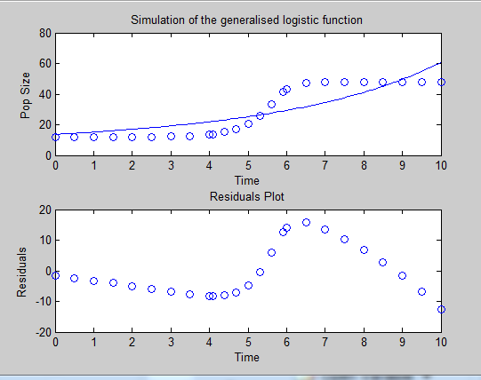
Find Optimal Parameter Set
z=Cost(p0,1);
p2=fminsearch(@Cost,p0,[],0)
z=Cost(p2,1);
Value of cost function with optimization:
ans =
1.6634e+03
>>
Lesson: Optimizer may fail if initial guesses are bad.
Select better values through trial and error, based on data fit.
Notes:
Fminsearch fails if guestimates are bad.

Slide 18
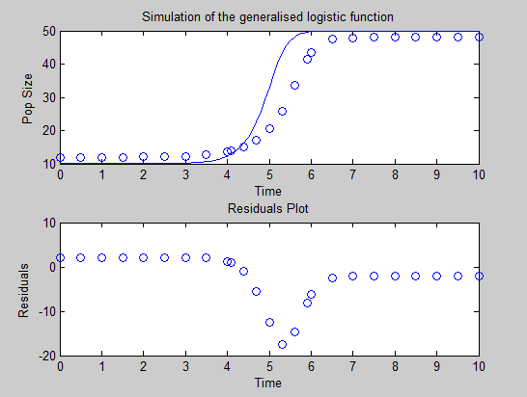
Find Optimal Parameter Set
z=Cost(p0,1);
% p2=fminsearch(@Cost,p0,[],0)
% z=Cost(p2,1);
ans = 881.8760
Notes:
Hand-select better start values. Check each with z=Cost(p0,1).
p0=[10 % the lower asymptote
50 % the upper asymptote
5 % the growth rate
2 % how max. growth occurs
2 % Depend. on y(0)
5]; % the time of max growth

Slide 19
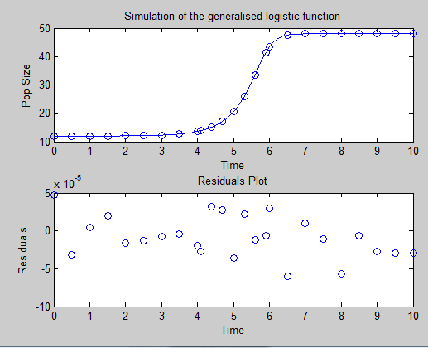
Find Optimal Parameter Set
z=Cost(p0,1);
p2=fminsearch(@Cost,p0,[],0)
z=Cost(p2,1);
Initial guesses from previous page;
Result:
p2 =
12.0000
48.0000
4.9999
3.0000
3.1107
5.6344
ans =
1.9440e-08
>>
Notes:
With better guestimate, fminsearch succeeds.

Slide 20
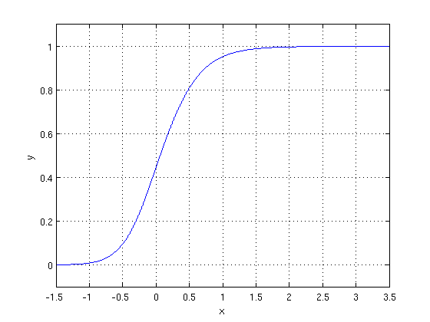
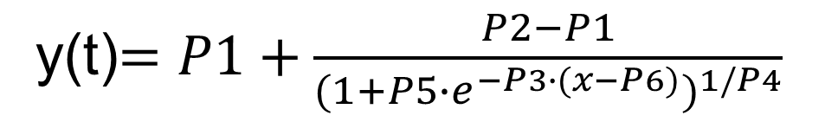
y(t)$=P1+\frac{P2−P1}{{(1+P5∙e^{−P3∙(x−P6)})}^{1/P4}}$
P2
P6
P3
P1
P4 – Determines the shape

Slide 21
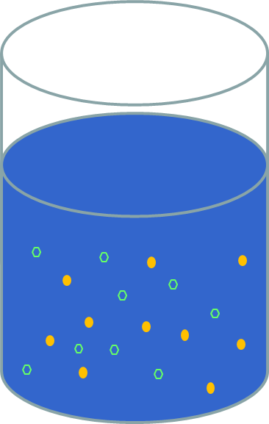
Exercise 2 – Monod’s Equation
Dynamics of a bacterial culture growing on glucose in a fermenter.
Variables:
Glucose concentration: X₁
Biomass (~number of cells): X₂
Load Opt_Monod.m

Slide 22
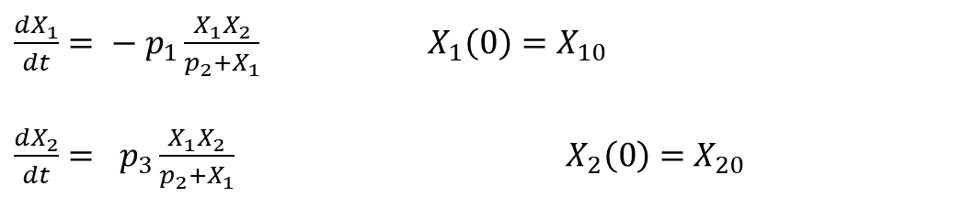
Exercise 2 – Monod’s Equation
ODEs.
$\frac{{dX}_{1}}{dt}= − p_{1}\frac{X_{1}X_{2}}{p_{2}+X_{1}}$ $X_{1}\left(0\right)=X_{10}$
$\frac{{dX}_{2}}{dt}= p_{3}\frac{X_{1}X_{2}}{p_{2}+X_{1}}$ $X_{2}\left(0\right)={ X}_{20}$
Rates
Glucose consumption
(Michaelis-Menten):
Growth:
Notes:
Matlab file is a bit confusing as the first two “parameters” in p-vector are initial values; they are different from p(1) and p(2).

Slide 23
Monod’s data
function z=dataset(dataset,Met)
switch dataset
case 2
switch Met
case 'glc'
z=[ 0 40
1 39.6
2 38.5
3 35.4
4 27.4
5 11.3
6 0.7
7 0.01
8 0
9 0
10 0];
case 'cells'
z=[ 0.25 0.26e6
1.25 0.74e6
2.25 2.12e6
3.25 5.92e6
3.75 9.71e6
4.25 15.5e6
4.75 23.5e6
5.25 32.0e6
6.25 38.6e6
7.25 38.9e6
10.00 38.9e6];
end
end
end
Notes:
'Display’, =
'final’ = only the final result

Slide 24
Monod’s Equation
function [z pars]=Opt_Monod()
clc
p0=[10 % Initial concentration of glucose
1 % Initial amount of cells
.5 % Vmax for glucose transp
15 % Km for glucose transp
1]; % umax max. growth rate
z=Cost(p0,1);
% options=optimset('Display','iter');
% p2 = fminsearch(@Cost,p0,options,0)
% z = Cost(p2,1);
% pars = p2
end
function [z DSE]=Cost(pp,g)
p=abs(pp);
x0=[p(1)
p(2)*1e6];
Tspan=0:.1:10;
[t,y]=ode23s(@My_ode,Tspan,x0,[],p(3:5));
glc=dataset(2,'glc');
cells=dataset(2,'cells');
Sim_glc=interp1(t,y(:,1),glc(:,1));
Sim_cells=interp1(t,y(:,2),cells(:,1));
DSE=[(Sim_glc-glc(:,2)); (Sim_cells-cells(:,2))];
Cost=sum(DSE.^2);
if g==1
% Plotting our data and simulation!
end
z = Cost
DSE = DSE
end
function dxdt=My_ode(t,x,p)
dxdt=[-1e-6*(p(1)*x(2)*x(1)/(p(2)+x(1)))
p(3)*x(2)*x(1)/(p(2)+x(1))];
end
Notes:
'Display’, =
'final’ = only the final result

Slide 25
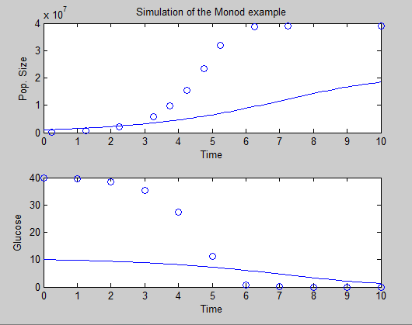
Monod’s Equation without Optimization
p0=[10 % Initial concentration of glucose
1 % Initial number of cells
.5 % Vmax for glucose transp
15 % Km for glucose transp
1]; % umax max. growth rate
z=Cost(p0,1);
% options=optimset('Display','iter');
% p2 = fminsearch(@Cost,p0,options,0)
% z = Cost(p2,1);
% pars = p2
Cost = 3.0488e+15

Slide 26
First Optimization
p0=[10 % Initial concentration of glucose
1 % Initial number of cells
.5 % Vmax for glucose transp
15 % Km for glucose transp
1]; % umax max. growth rate
z=Cost(p0,1);
options=optimset('Display','iter');
p2 = fminsearch(@Cost,p0,options,0)
z = Cost(p2,1);
pars = p2
Cost = 4.4507e+08
?
Notes:
Explain why glucose profile is so bad.

Slide 27
Datasets
function [z DSE]=Cost(pp,g)
p=abs(pp);
x0=[p(1)
p(2)*1e6];
Tspan=0:.1:10;
[t,y]=ode23s(@My_ode,Tspan,x0,[],p(3:5));
glc=dataset(2,'glc');
cells=dataset(2,'cells');
Sim_glc=interp1(t,y(:,1),glc(:,1));
Sim_cells=interp1(t,y(:,2),cells(:,1));
DSE=[(Sim_glc-glc(:,2)); (Sim_cells-cells(:,2))];
Cost=sum(DSE.^2);
if g==1
% Plotting our data and simulation!
end
z = Cost
DSE = DSE
end
case 2
switch Met
case 'glc'
z=[ 0 40
1 39.6
2 38.5
3 35.4
4 27.4
5 11.3
6 0.7
7 0.01
8 0
9 0
10 0];
case 'cells'
z=[ 0.25 0.26e6
1.25 0.74e6
2.25 2.12e6
3.25 5.92e6
3.75 9.71e6
4.25 15.5e6
4.75 23.5e6
5.25 32.0e6
6.25 38.6e6
7.25 38.9e6
10.00 38.9e6];
end
DSE =
1.0e+07 *
-0.0000
-0.0000
-0.0000
-0.0000
-0.0000
-0.0000
0.0000
0.0000
0.0000
0.0000
0.0000
0.0845
0.0903
0.0303
-0.2389
-0.5474
-1.0445
-1.7504
-2.4942
-2.9084
-2.6647
-2.0446
DSE =
1.0e+04 *
-0.0026
-0.0025
-0.0025
-0.0023
-0.0018
-0.0007
-0.0000
-0.0000
0.0000
0.0000
0.0000
-0.1660
0.1662
-0.4654
-0.5085
-0.0345
1.1999
-0.6945
-0.0940
1.1399
-0.8058
-0.1986

Slide 28
Scaling the Cost Function
function [z DSE]=Cost(pp,g)
p=abs(pp);
x0=[p(1)
p(2)*1e6];
Tspan=0:.1:10;
[t,y]=ode23s(@My_ode,Tspan,x0,[],p(3:5));
glc=dataset(2,'glc');
cells=dataset(2,'cells');
Sim_glc=interp1(t,y(:,1),glc(:,1));
Sim_cells=interp1(t,y(:,2),cells(:,1));
DSE=[(Sim_glc-glc(:,2)); (Sim_cells-cells(:,2)) * 1*e-6 ];
Cost=sum(DSE.^2);
if g==1
% Plotting our data and simulation!
end
z = Cost
DSE = DSE
end
Cost = 3.1630

Slide 29
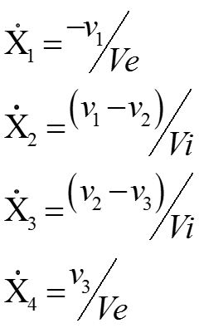
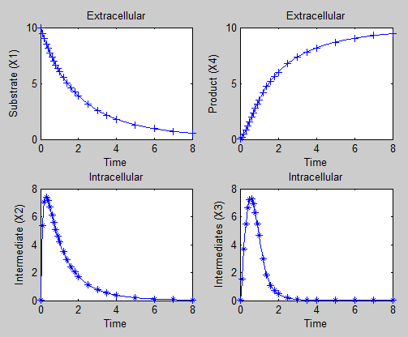
Exercise 3 – Linear Pathway (HW)
Ve=50
Initial values
X₁=10
X₂=0.001
X₃=0.001
X₄=0.001
Vi=2.5
X₁
v₁
X₂
v₂
X₃
v₃
X₄
v=[p(1)*x(1)^p(2)
p(3)*x(2)^p(4)
p(5)*x(3)^p(6)]
Opt_LinearPath.m

Slide 30
Linear Pathway data
function z=dataset(dataset,Met)
switch dataset
case 3
z=[ 0 10.0000 0.0010 0.0010 0.0010
0.1000 9.4838 5.3635 1.5358 0.1723
0.2000 9.0006 7.0424 3.6830 0.4643
0.3000 8.5477 7.3807 5.4507 0.8119
0.4000 8.1229 7.1486 6.6203 1.1898
0.5000 7.7242 6.6813 7.1927 1.5832
0.6000 7.3496 6.1415 7.2537 1.9817
0.7000 6.9975 5.6013 6.9140 2.3779
0.8000 6.6662 5.0926 6.2931 2.7656
0.9000 6.3543 4.6263 5.5022 3.1404
1.0000 6.0604 4.2041 4.6388 3.4986
1.2000 5.5218 3.4830 3.0099 4.1546
1.4000 5.0418 2.8999 1.8135 4.7236
1.6000 4.6129 2.4259 1.1013 5.2119
1.8000 4.2286 2.0386 0.7046 5.6354
2.0000 3.8835 1.7205 0.4693 6.0081
2.5000 3.1630 1.1454 0.1854 6.7716
3.0000 2.6021 0.7795 0.0789 7.3561
3.5000 2.1602 0.5410 0.0354 7.8121
4.0000 1.8082 0.3820 0.0166 8.1729
5.0000 1.2953 0.1994 0.0040 8.6956
6.0000 0.9521 0.1097 0.0011 9.0435
7.0000 0.7153 0.0630 0.0003 9.2826
8.0000 0.5478 0.0376 0.0001 9.4514];
end
end
Notes:
'Display’, =
'final’ = only the final result

Slide 31
Linear Pathway data
function dxdt=My_ode(t,x,p)
Vi=2.5; Ve=50;
v=[p(1)*x(1)^p(2)
abs(p(3))*x(2)^abs(p(4))
abs(p(5))*x(3)^abs(p(6))];
dxdt=[-v(1)/Ve
v(1)/Vi-v(2)/Vi
v(2)/Vi-v(3)/Vi
v(3)/Ve];
end
Notes:
'Display’, =
'final’ = only the final result

Slide 32
Linear Pathway data
function z=Cost(pp,g)
p=abs(pp);
x0=[10
.001
.001
.001];
Tspan=0:.05:8;
[t,y]=ode23s(@My_ode,Tspan,x0,[],p);
DataE=dataset(3);
DataS=interp1(t,y(:,:),DataE(:,1));
DSE=[DataE(:,2:5)-DataS];
Cost=sum(sum(DSE.^2));
if g==1
% Plotting our data and simulation!
end
z=Cost;
end

Slide 33
Linear Pathway data
function [z pars]=Opt_LinearPath()
clc
p0=[1 % Rate constant for V1
0.5 % Kinetic order for V1
1 % Rate constant for V2
.5 % Kinetic order for V2
1 % Rate constant for V3
.5]; % Kinetic order for V3
z=Cost(p0,1);
options=optimset('Display','iter');
p2=fminsearch(@Cost,p0,options,0)
z=Cost(p2,1);
pars = p2
end
Notes:
'Display’, =
'final’ = only the final result

Slide 34
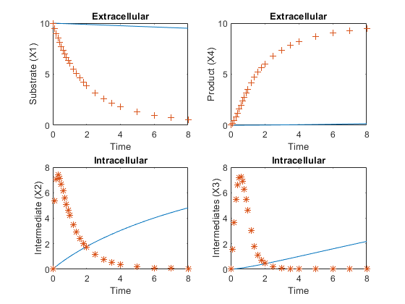
Linear Pathway data
Initial guess

Slide 35
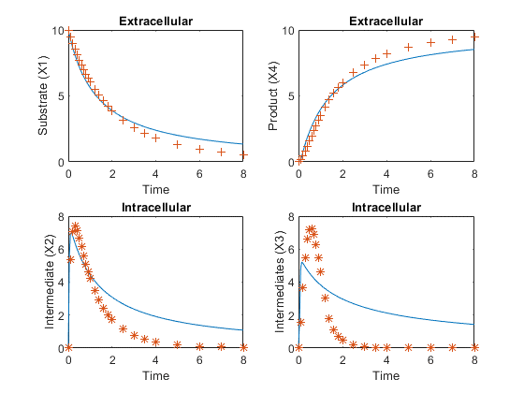
Linear Pathway data
First optimization run
Notes:
p0=[15 1.25 60 .65 110 .3];

Slide 36
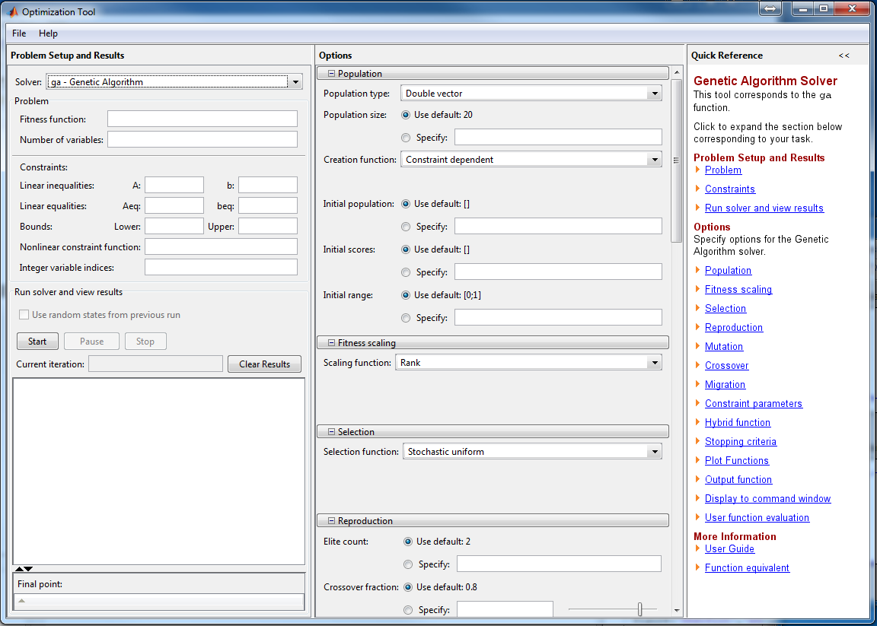
Optimization tool (optimtool)

Slide 37
Data Management (MS Excel)
[num,txt,raw] = xlsread(filename,sheet,range)
status = xlswrite(filename,A,sheet,range)

Slide 38
Parameter Estimation in Excel
Import or type data into Excel. Here, download file “ParaData.xlsx” from Canvas.
Data consist of two columns next to each other: x and f(x)
Define the model in a new column, starting in the same row as x and f(x).
Specify parameters as references to cells (e.g., $H$4)
Specify initial guesses of all parameter values in a continuous range of cells, as specified in (3).
Plot the graph of data and model, using scatter plot option. In this manner you may visualize what happens when the parameter values are changed.
Define a new column with the squared errors between each data point and the model prediction (e.g., = (G20 - H20)^2)
In a separate cell calculate the sum of the squared errors (SSE).
Select the cell where the SSE is calculated and select in the Data tab > Analysis group the option Solver.
In Set Target Cell (or Set Objective) leave the cell where SSE was calculated.
Choose Min to perform a minimization
In By Changing Cells select the range of cell where the parameter values were typed.
Press Solve.

Slide 39
Links:
Comparison of 6 optimization methods in matlab:
https://www.mathworks.com/help/gads/example-comparing-several-solvers.html
Optimization in Python:
https://www.youtube.com/watch?v=M7ZA9fq2zCE
Optimization in R:
https://www.youtube.com/watch?v=Qvye1wDa0kk

Slide 40
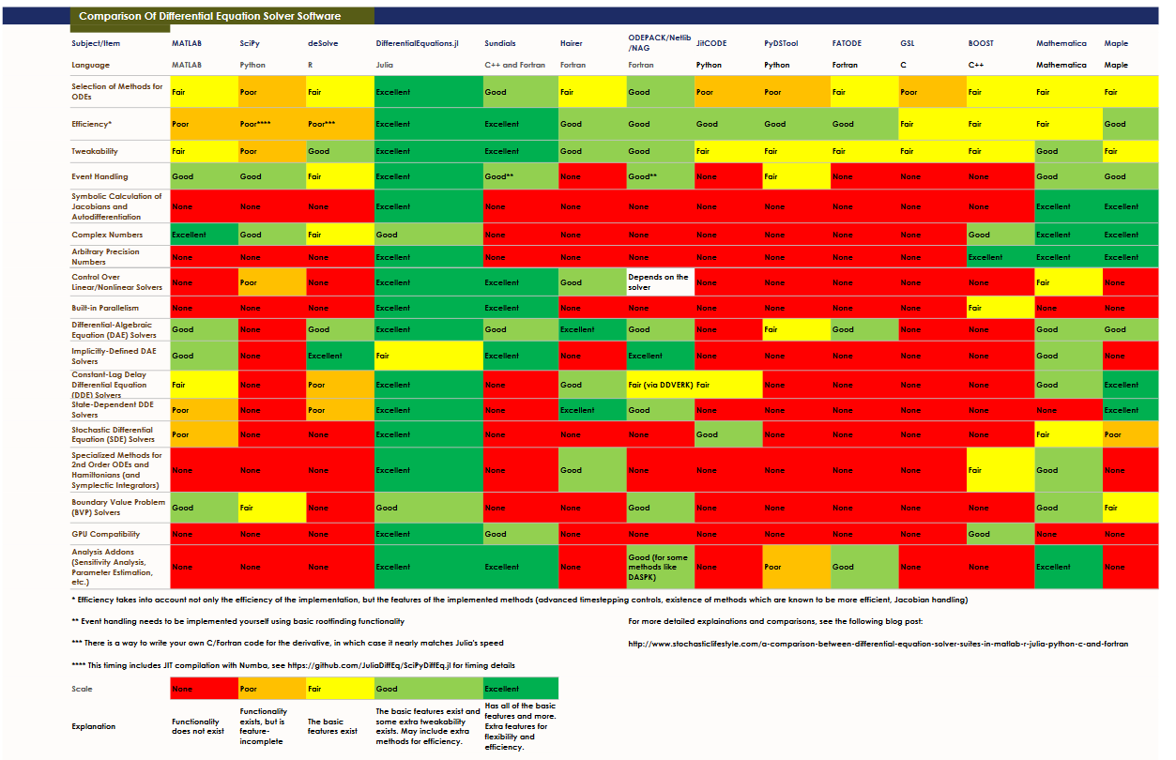
http://www.stochasticlifestyle.com/comparison-differential-equation-solver-suites-matlab-r-julia-python-c-fortran/

Slide 41
Project 1: Fitting a Hill function
1.1. Define the Hill function and other specifications as outlined above and estimate parameters. Record the optimal parameter values.
1.2. Use only data from x=0 to x=14. Estimate again. Discuss results.
1.3. Use only data from x=16 to x = 30. Estimate again. Discuss results.
1.4. Use only data from x=20 to x = 50. Estimate again. Discuss results.
Note: If you define additional SSEs for 1.2-1.4, make sure to adjust the “Objective.”
1.5. Impose constraints:
In the Subject to the Constraints box, enter any constraints that you want to apply by doing the following:
In the Solver Parameters dialog box, click Add.
In the Cell Reference box, enter the cell reference or name of the cell range for which you want to constrain the value.
Click the relationship ( <=, =, >=, int, bin, or dif ) that you want between the referenced cell and the constraint. If you click int, integer appears in the Constraint box. If you click bin, binary appears in the Constraint box. If you click dif, alldifferent appears in the Constraint box.

Slide 42

Project 2: Kinetic Function with Inhibitor
2.1. Download data from file “ParaData_Inhib.xlsx.” They are results of a fictitious experiment with different substrate (S) and inhibitor (I) concentrations. Assume the following model:
$$v= \frac{a S}{b \left(1+\frac{I}{c}\right)+d S}$$
Set up an estimation routine in Excel and estimate parameters. Start with different guestimates; compare and interpret the results.
2.2. Select one of the parameters in 2.1 and constrain it to some positive value of your choice. Re-optimize and check the SSE. Fix another parameter and re-optimize. Explain.
2.3. Constrain two of the parameters in 2.1 and re-optimize. Discuss your results.

